Slide 1

Islamic / Ethical Fintech in cash dominated Economies risks and opportunities for Banks/Regulators
www.gojabu.com

Slide 2
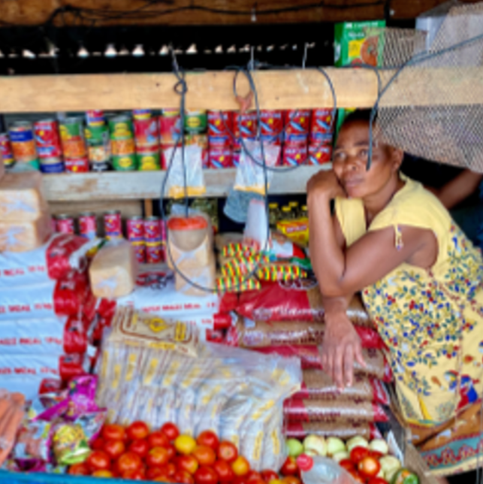
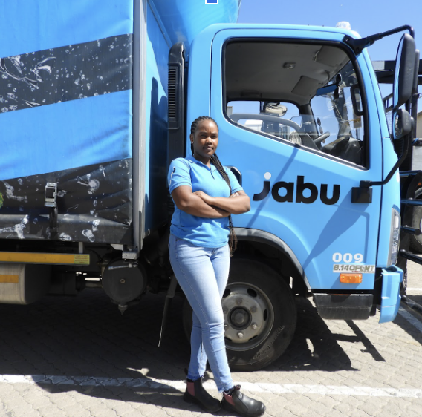
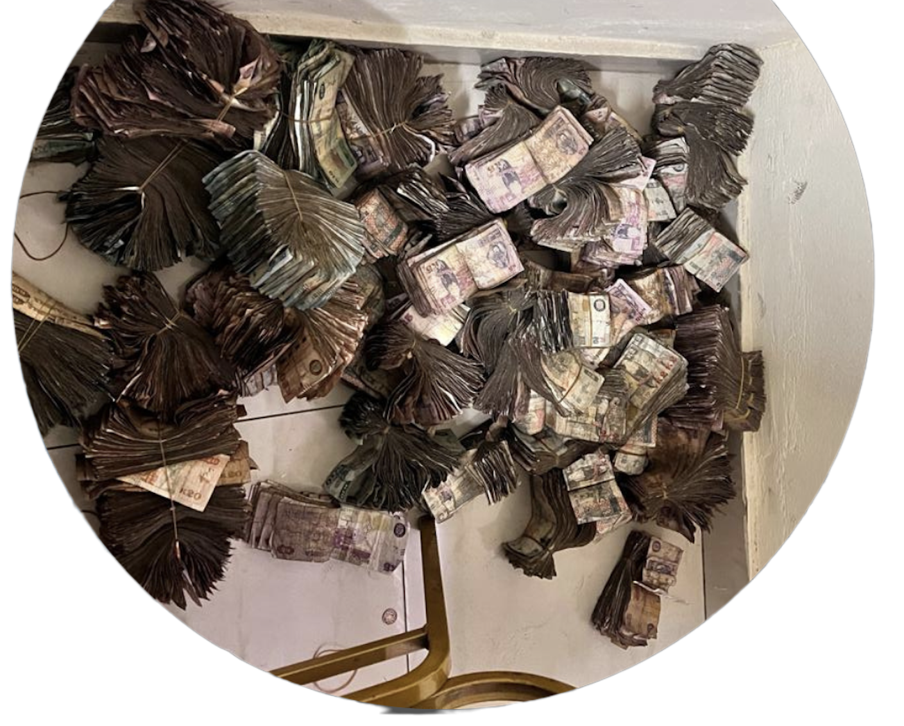
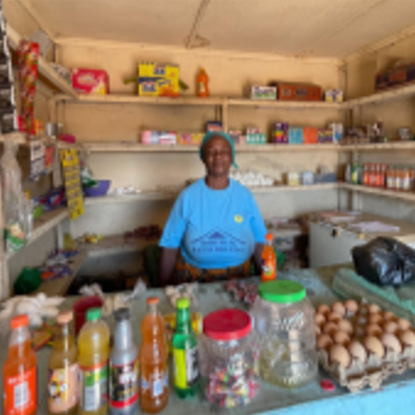
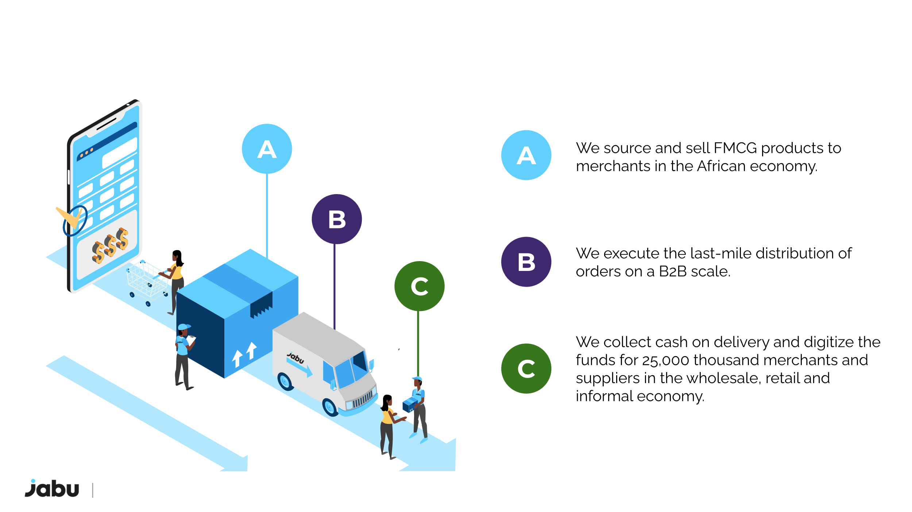


Jabu is a pioneer in the
Southern African B2B Space
A
We source and sell FMCG products to merchants in the African economy.
B
We execute the last-mile distribution of orders on a B2B scale.
We collect cash on delivery and digitize the funds for 25,000 thousand merchants & suppliers in the wholesale, retail and informal economy.
C
$500B+ in retail cash remains offline in Sub-Saharan Africa
www.gojabu.com

Slide 3
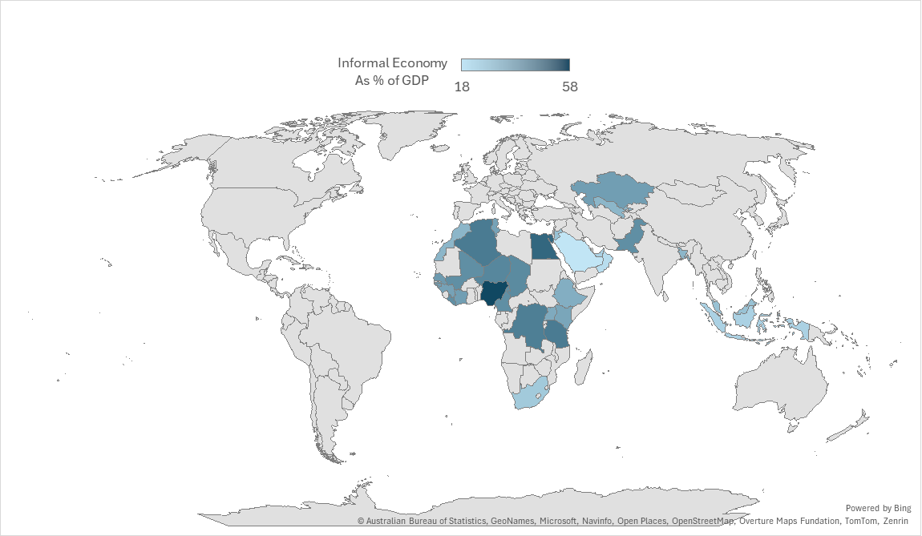
Across the Islamic World - Trade (especially informal) is dominated by Cash
Country | Informal % of GDP | Cash Usage
Nigeria | 58 | Very High
Egypt | 50 | Very High
Algeria | 45 | Very High
Pakistan | 40 | Very High
Senegal | 37 | Very High
Ivory Coast | 36 | Very High
Tunisia | 35 | Very High
Indonesia | 23 | High
UAE | 23 | Medium
Bahrain | 22 | Medium
Saudi Arabia | 18 | High

Slide 4
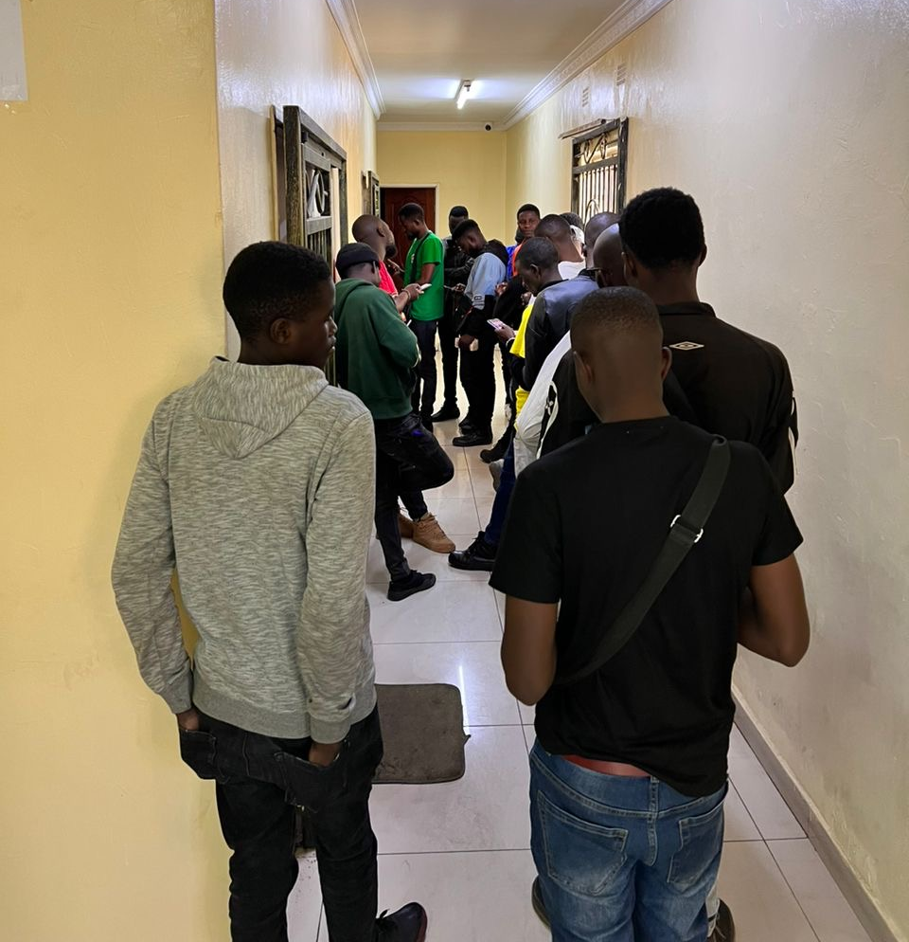
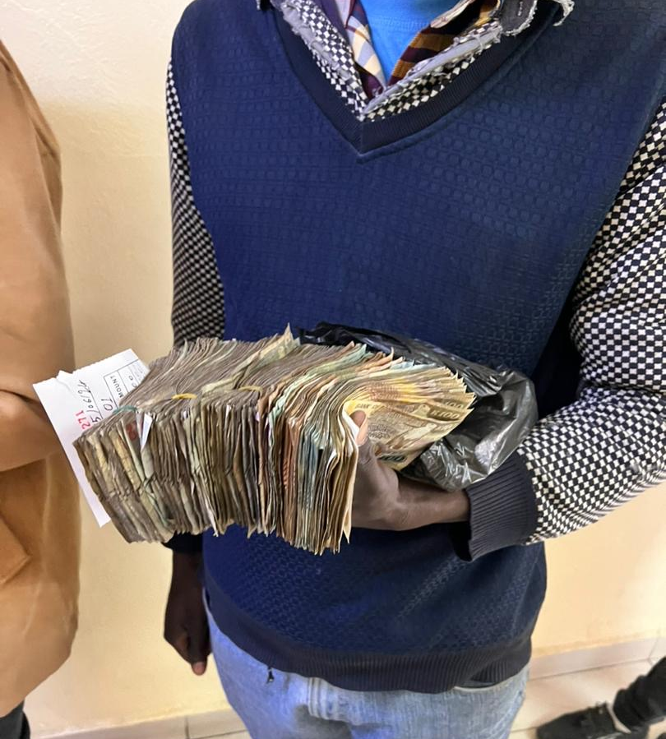
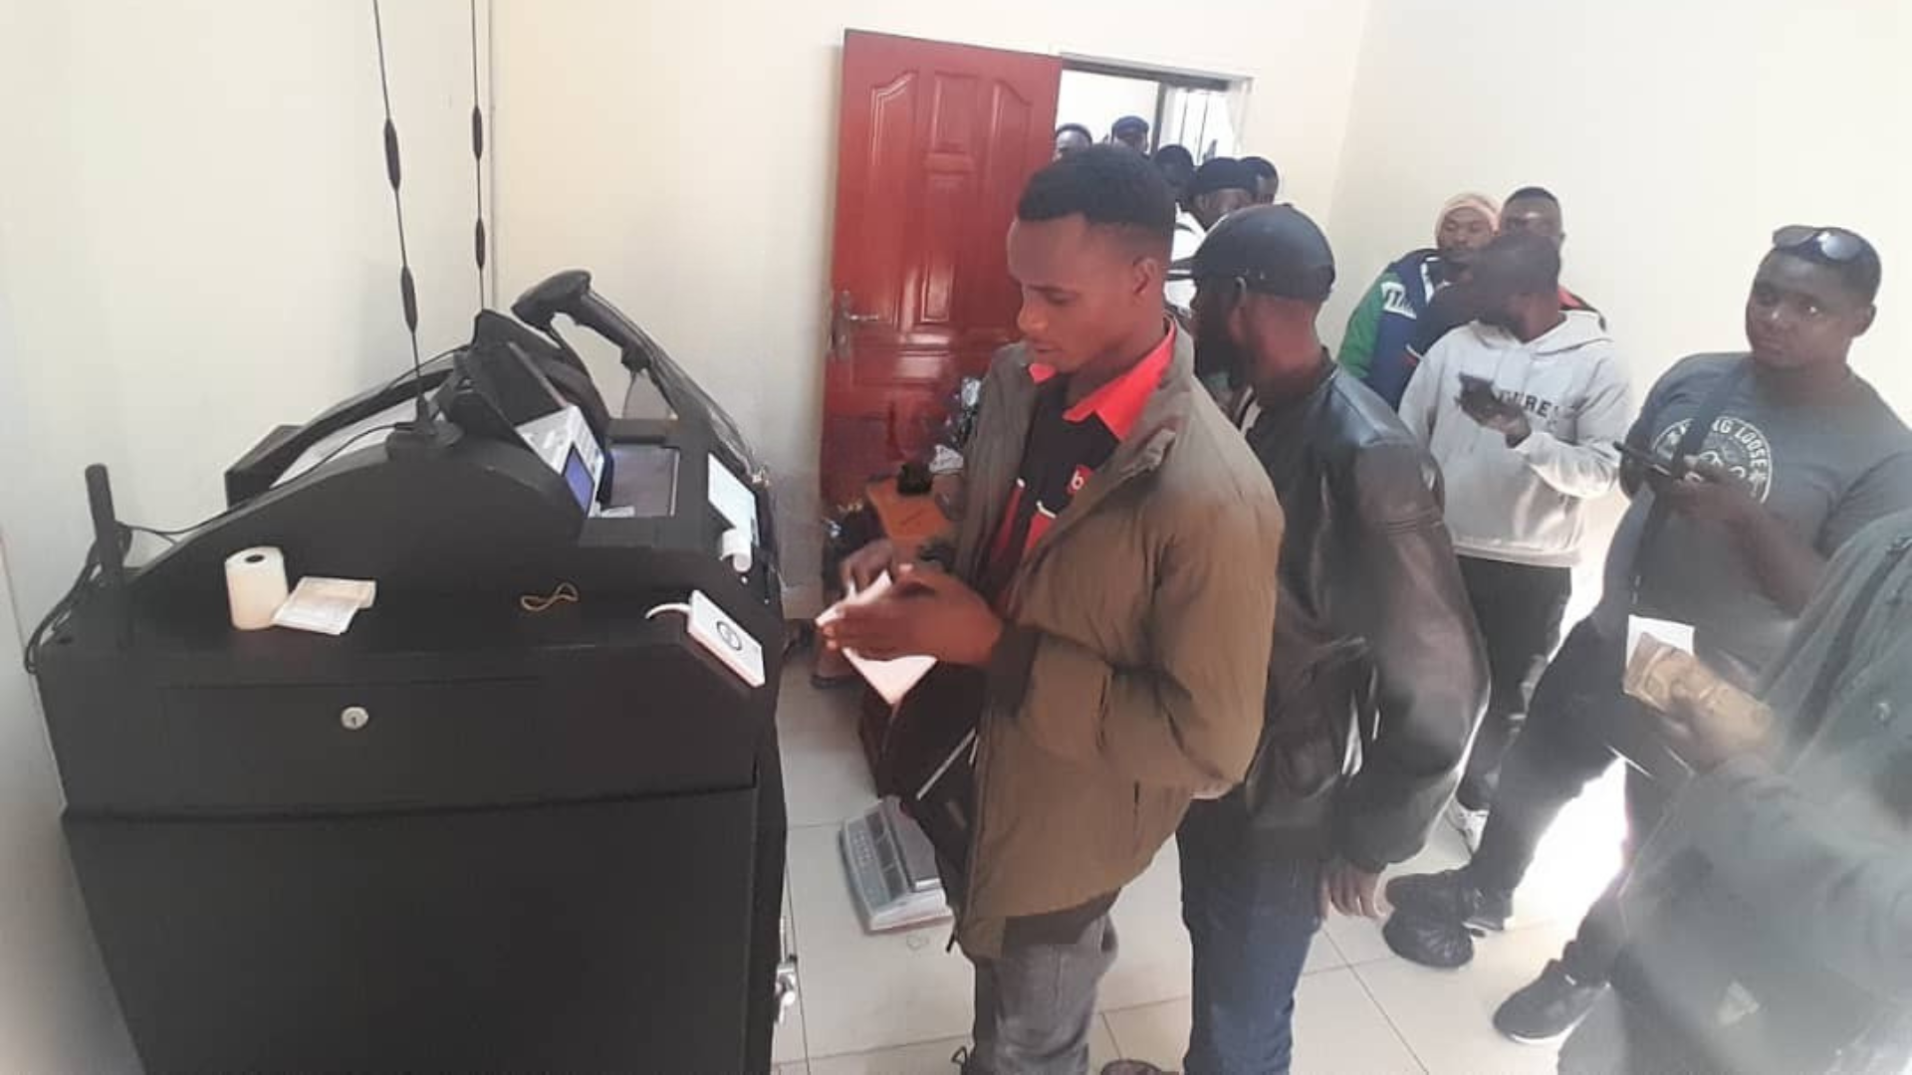
There are however few options for businesses that want to move away from Cash when the Economy is Cash driven
Drivers from Zambia’s largest distributor depositing over $ 100,000 daily
www.gojabu.com

Slide 5
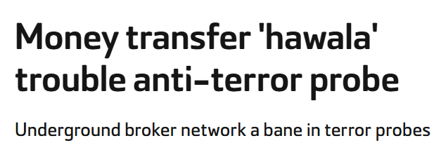
For Banks / Central Banks: Cash presents a challenge for compliance on KYC, AML and FATF targeting
“A pervasive and growing dollarized cash economy is a major impediment to Lebanon’s economic recovery,” a World Bank report said.

Slide 6
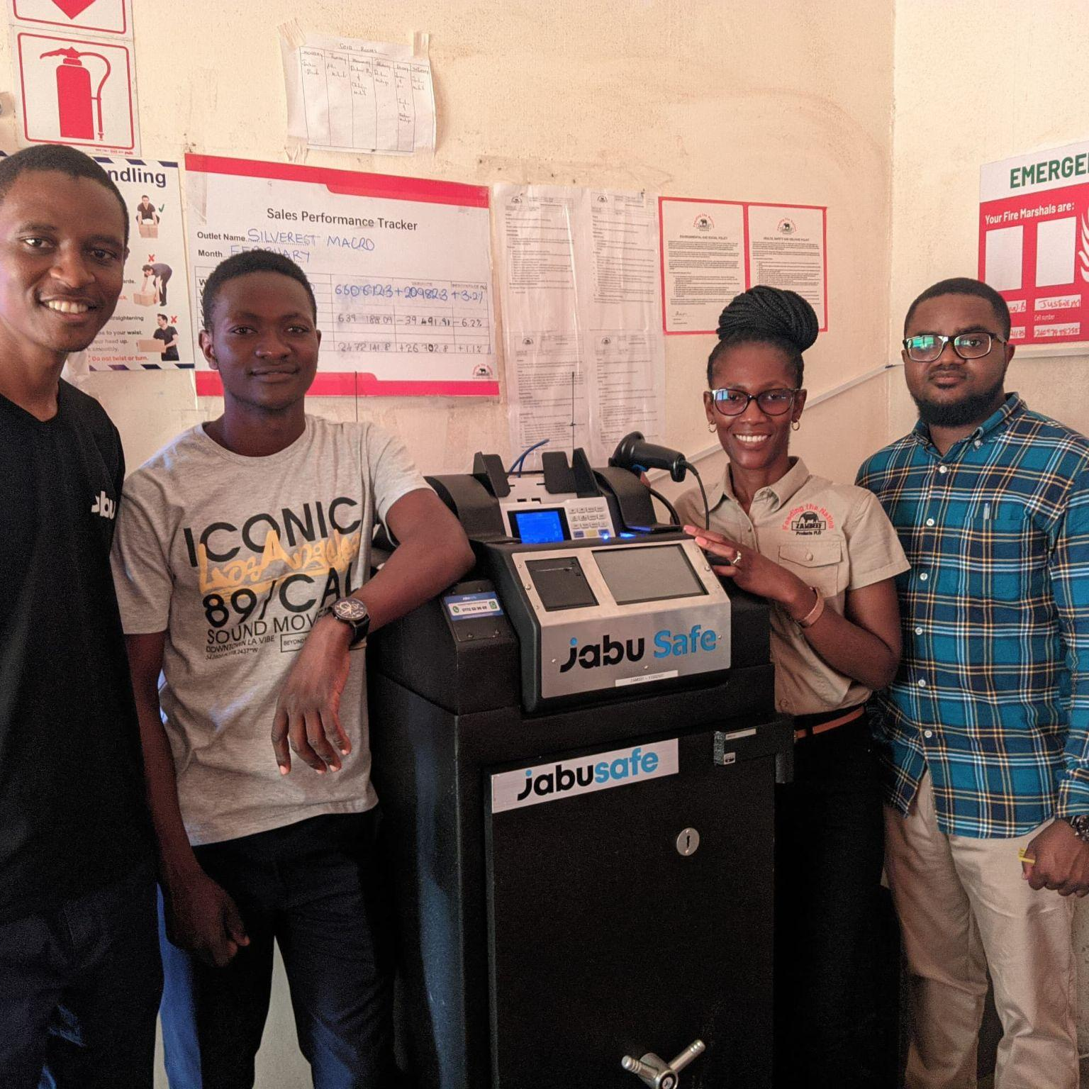
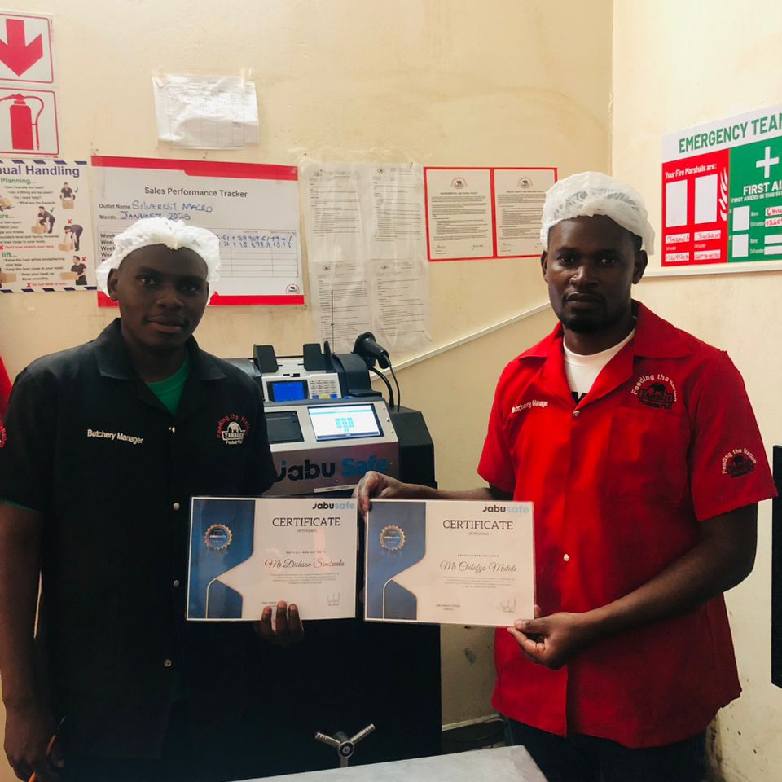
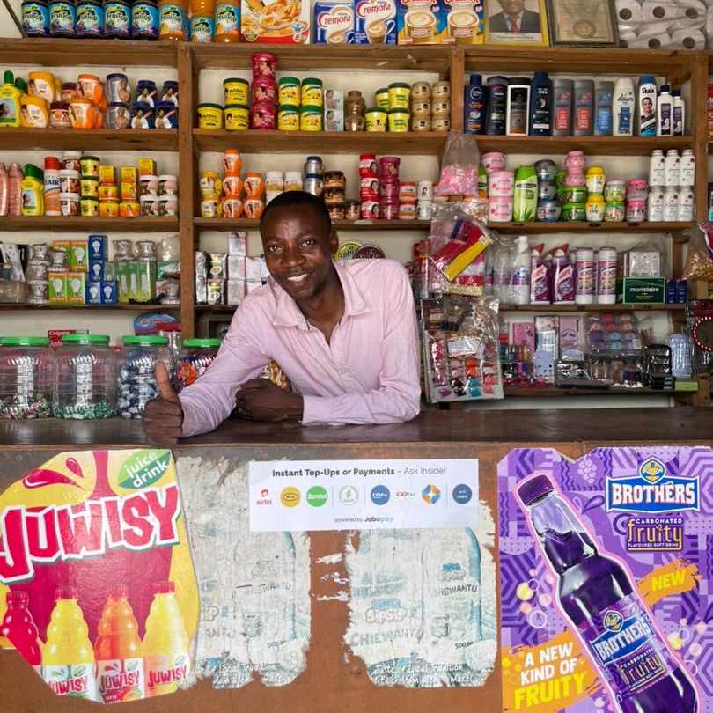








Case Study: Jabu - Real time Cash digitization across Africa Through Established Partnerships with Banks, Central Banks & Customers
Sénégal
$ 1M
Monthly Flows of Over $ 100M in Expansion Region
Côte d'Ivoire
$ 17M
Togo
$ 15M
Active
Markets
Over $ 1B
www.gojabu.com

Slide 7

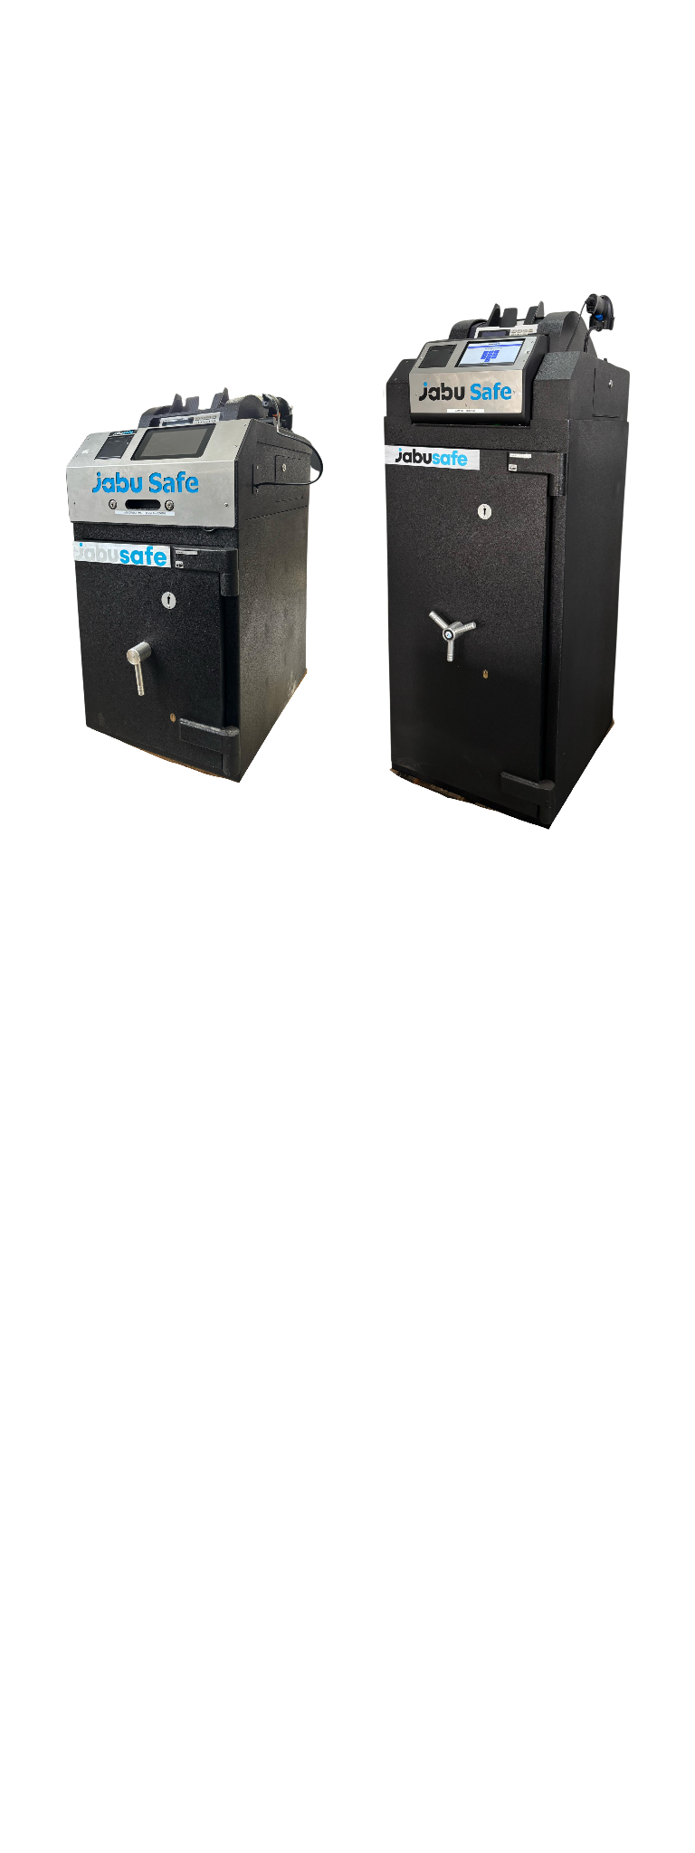
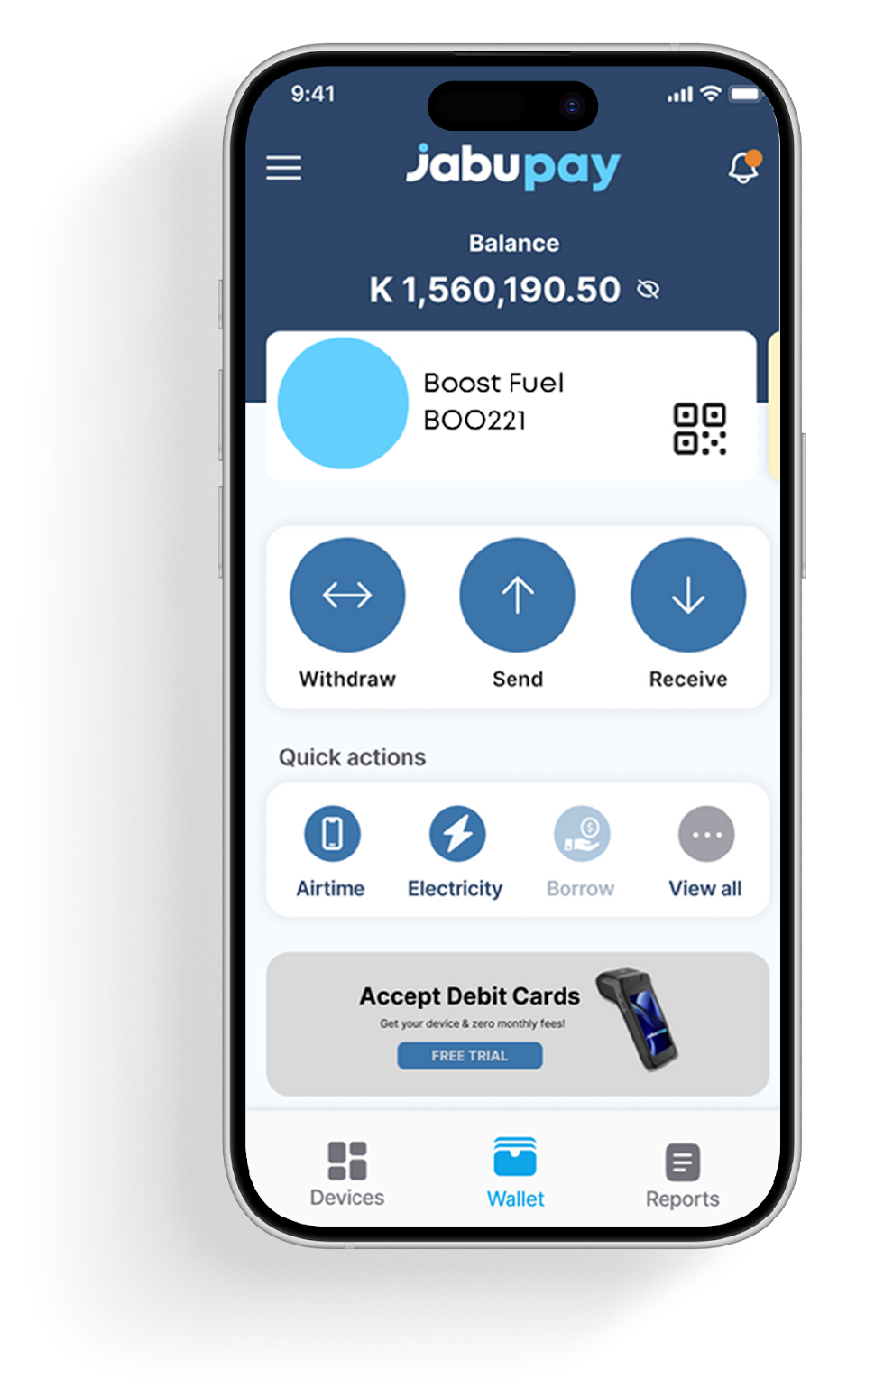

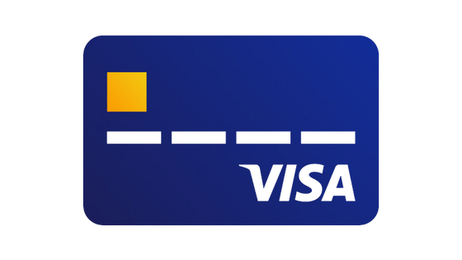


Case Study: Flows Optimized for Murabaha and Musharakah Transactions
Cash to X Conversion
Digitise cash
at the JabuSafe Inside their shop
Balance is
instantly added
Funds split nad Swept funds instantly to
STORE
Businesses
MNO’s & Wallets
Jabu business model includes a monthly professional service fee, an instant cash fee on all processed volume, as well as through processing fees and VAS reselling.
www.gojabu.com

Slide 8
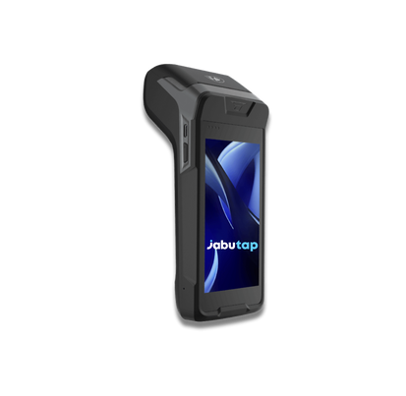




The Jabu Ecosystem empowers Central Banks and Commercial Banks across Africa by formalising the Informal
01.
02.
03.
Cash Reconciliation and Transactions
Bulk Cash Payments
Prepaid Card and Card Machines
www.gojabu.com

Slide 9
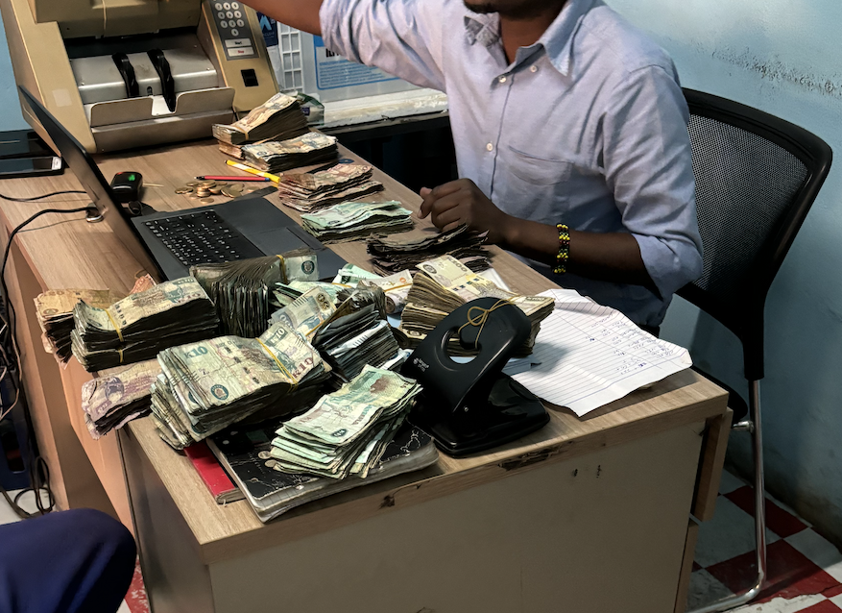
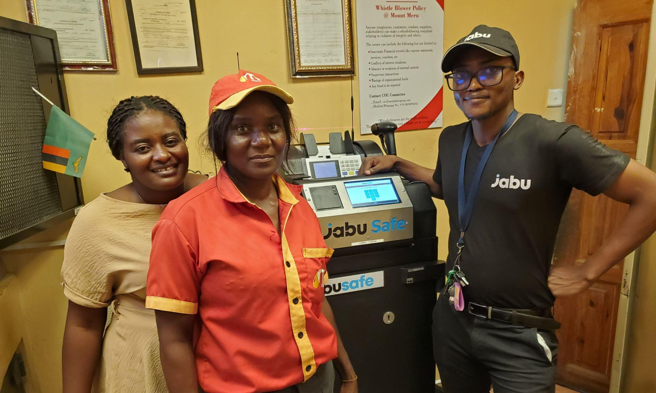
Cash is still king. Fintech operations make it traceable, cuts risk,
Provides easy reconciliation and brings it within Regulatory oversight
www.gojabu.com

Slide 10












Case Study: Jabu is Currently Digitizing Billions in the Value Chain From Manufacturers & Fuel Providers, Down to the small Shops
Monthly Avg Value Per User
Brands
USD 700,000
Per customer branch
Manufacturers
Big distributors
USD 280,000
Petrol stations
Per customer branch
Supermarket
Wholesalers
Mini markets
USD 10,000
Informal sector merchants
Per customer branch
Savings groups
www.gojabu.com

Slide 11
QUESTIONS?

